Slide 1
Stellar stories
EVENT: NASA SPACE APP CHALLENGE
Team: space seekers

Slide 2
Problem statement
Space is not silent- sun always sends charged particles towards earth
During solar flares, coronal mass ejections, and geomagnetic storms, earth’s systems are impacted:
Disruptions in satellite communication and gps navigation
Failures in power grids
Effects on astronaut safety and aviation
However:
Public awareness is limited
No accessible platform exists for students, enthusiast ,or citizen scientists to log and share their local observation of space weather.
OUR CHALLENGE: How can we connect a everyday people to space weather events in a simple, Interactive way?

Slide 3
OUR SOLUTION
We created Space Weather Log, a web-based tool to record and share space weather observations.
Core Features:
Upload images of auroras, sunspots, or celestial events.
Add descriptions with date, time, and location.
Save entries as a personal logbook for space weather.
Our Role as Coders: Designed a modern, responsive interface using HTML & Tailwind CSS. Added JavaScript functions for: Live image preview on upload Smooth animations & interactivity Clean user experience, Implemented custom styling & dark theme to match space aesthetics . Wrote clear, optimized code to ensure the site runs smoothly on desktop & mobile.
Why it Matters: Encourages citizen science. Provides a hands-on learning platform for students. Demonstrates how coding + design can make science more engaging.

Slide 4
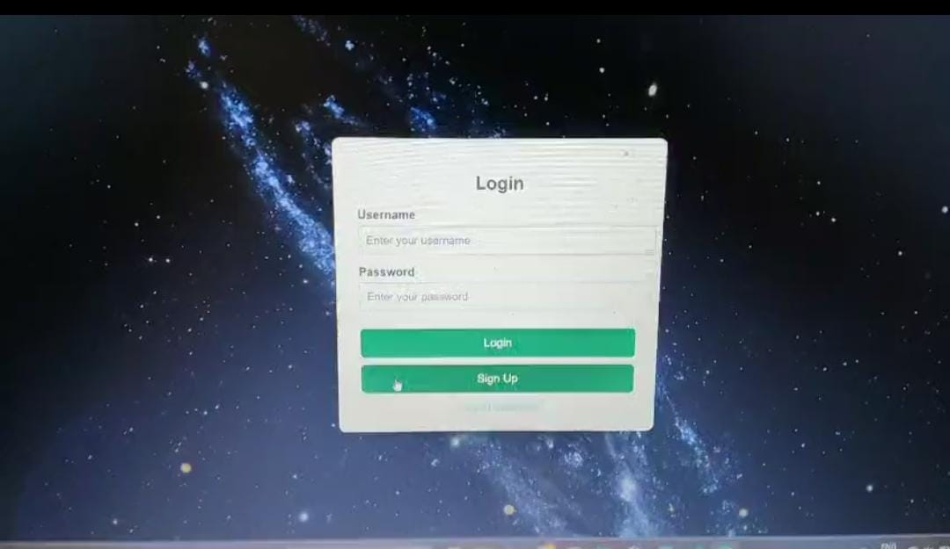
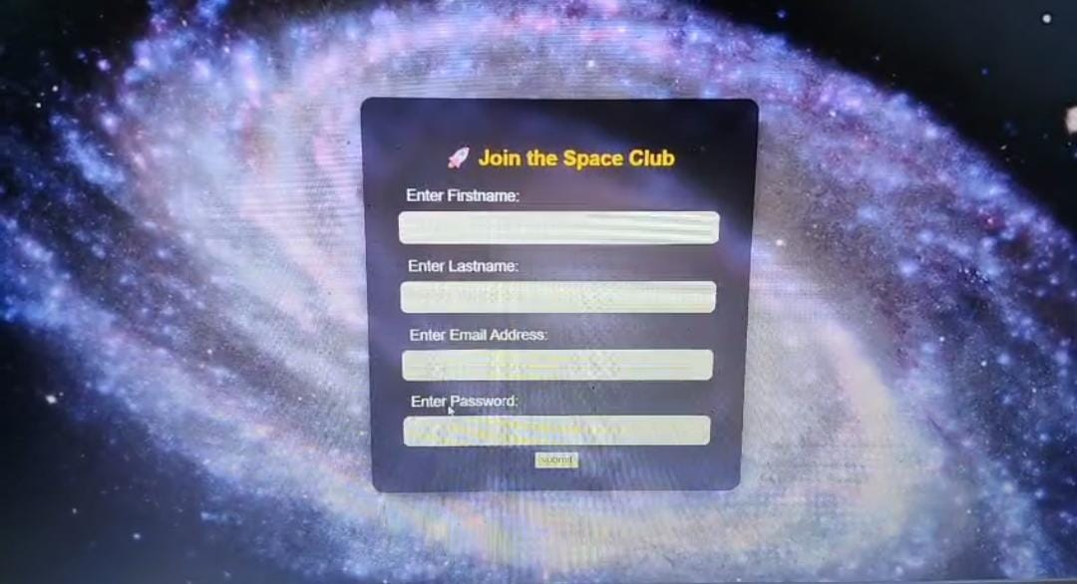
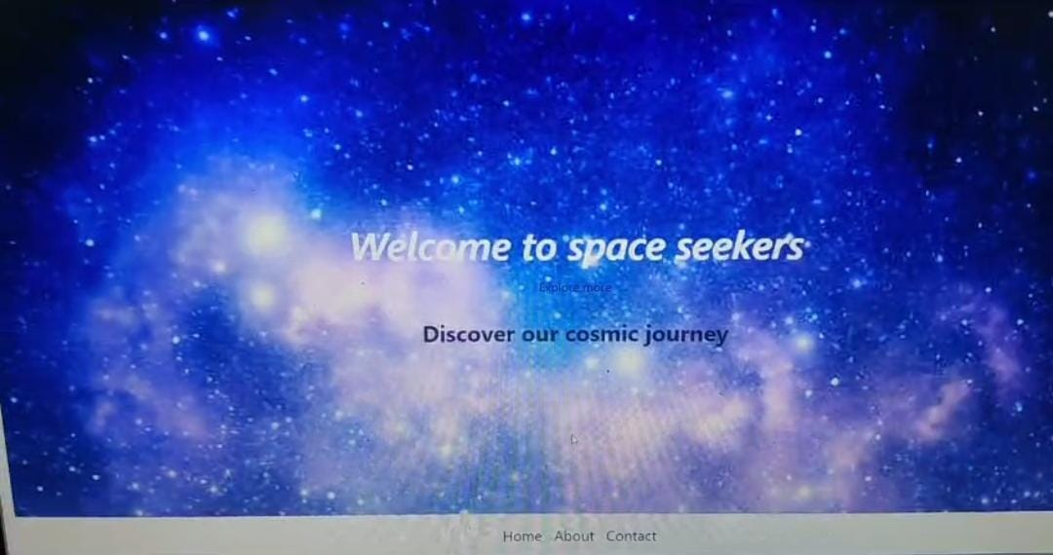
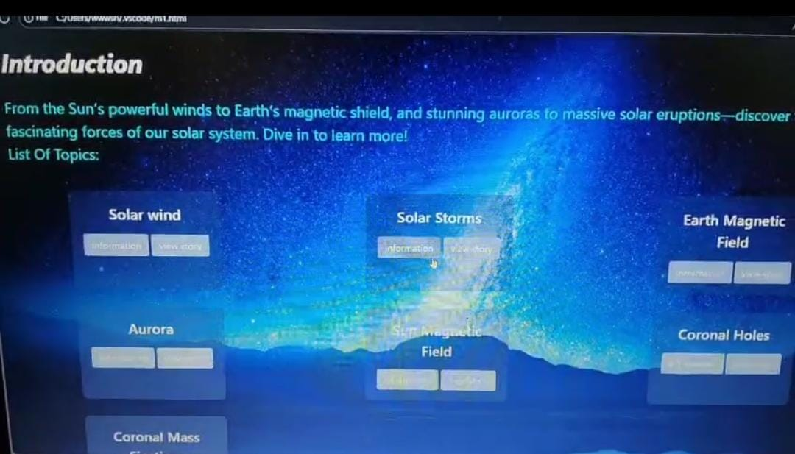
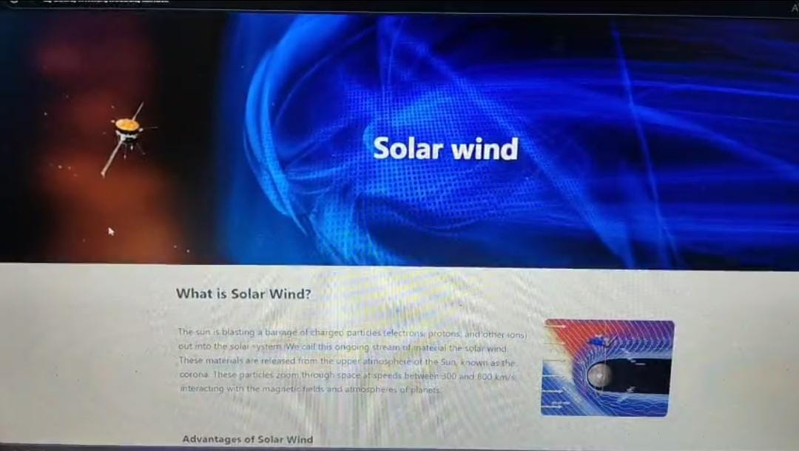
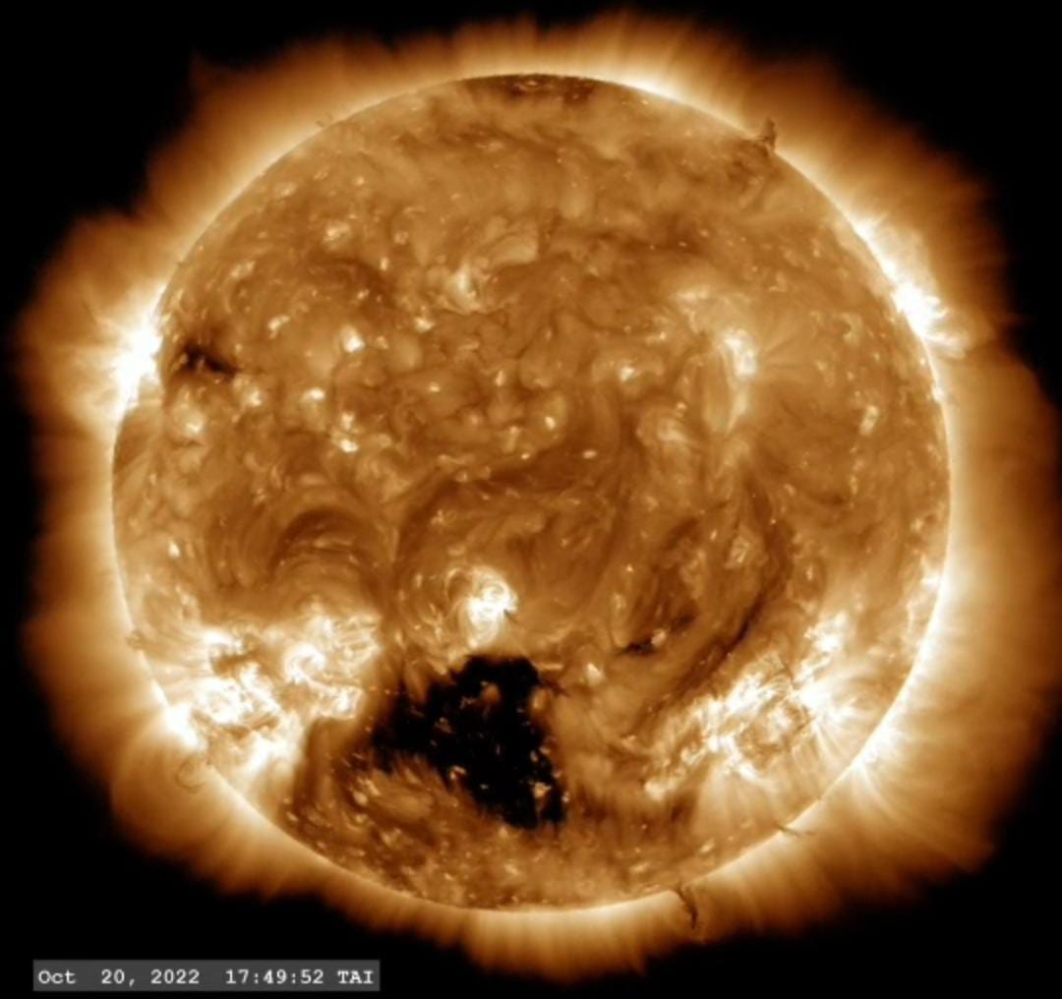
WEBSITE DEMO
Frontend: HTML5, Tailwind CSS for styling Logic: JavaScript for image preview & interactivity Design: Responsive UI, modern fonts, smooth animations

Slide 5
Use Cases & Impact
For Students & Astronomy Clubs: Record night-sky observations during events like auroras or eclipses and Share logs for collaborative learning.
For Citizen Scientists: Contribute real-time data during solar storms or geomagnetic activity and Build a community-driven archive of space weather.
For Researchers: Access grassroots observations that can complement NASA/ISRO space data.
For the General Public : Build curiosity & awareness about the Sun’s influence on Earth and Encourage community participation in science.
Objectives: Increase public engagement in space weather awareness. Build a user-friendly platform for documenting celestial events . Encourage citizen science by allowing real-time contributions .Create a digital logbook that can support research and education.

Slide 6
FUTURE SCOPE, IMPACT, BENEFITS, TECH STACK & TOOLS
Phase 1 – Data Storage : Integrate cloud databases so user logs are stored & accessible anytime.
Phase 2 – Collaboration Platform : Global gallery of uploaded observations . Users can like, comment, and compare logs across locations.
Phase 3 – AI & Automation : AI models classify uploaded images into categories (sunspots, auroras, eclipses, etc.).Provide suggested tags and insights.
Phase 4 – NASA API Integration : Live space weather alerts & solar storm data displayed alongside community logs . Vision: Create a worldwide citizen science network for monitoring space weather.
Impact & Benefits: Helps students & clubs record night sky events, Supports citizen scientists in contributing local space weather data, Useful for researchers by adding grassroots logs, Improves public awareness of the Sun’s impact on Earth.
Tech Stack & Tools Used : Frontend: HTML5, Tailwind CSS, Java Script Design & Fonts: Google Fonts (Inter), Tailwind styling Tools: VS Code, GitHub, Browser testing (Future scope: database, AI classification, NASA APIs)

Slide 7
CONCLUSION
Role 1 – Frontend & UI design
Role 2 – JavaScript coding & functionality
Role 3 – Research & content writing
Role 4 – Presentation & documentation
Team Space SeekersEvent : NASA Space Apps Challenge 2025 – Vishakapatnam
Slogan: Exploring Space, Inspiring Earth
Conclusion : Space Weather Log bridges science and society by making space weather events interactive and accessible, The Sun’s activity doesn’t just light up our sky — it shapes our technology, communication, and safety. Space Weather Log bridges the gap between cosmic events and human awareness .Our project makes space weather interactive, educational, and participatory.

